Slide 1
BCS 4.2 New User ECRS Request or Change Permission Request
Prepared by Defense Health Agency (DHA)

Slide 2
Overview
The DOEHRS-IH Business Objects reporting system is hosted in Business Intelligence Common Services (BCS)
BCS is integrated with the iAS Enterprise CAC Registration Services (ECRS)
ECRS is available for the submission of BCS 4.2 new user requests and for change requests to update account permissions.
The ECRS Approval Workflow facilitates the review and validation of user requests prior to provisioning users for access to BCS.

Slide 3
Overview
New users will need to submit a request in the DOEHRS-IH application to set access level for DW reports
Users who need access to run Business Objects reports will need to submit an ECRS request for DOEHRS-IH DW and/or DOEHRS-IH TR BCS applications

Slide 4
BCS ECRS Account Request
New user account requests will go through two processes in the ECRS portal prior to user account creation in BCS 4.2
Process 1: Submit a CAC Registration Request
Process 2: Submit an Automated Access Request Form (AARF) to gain access to BCS DOEHRS-IH DW and/or BCS DOEHRS-IH TR reporting application
Request Access Level for DOEHRS-IH DW
For DW access, new users will need to submit an additional Data Warehouse request in the DOEHRS-IH application to obtain access to Service/Region/Program Office level data
Existing users can also submit requests in the DOEHRS-IH application for additional Service/Region/Program Office level data to run DW reports

Slide 5
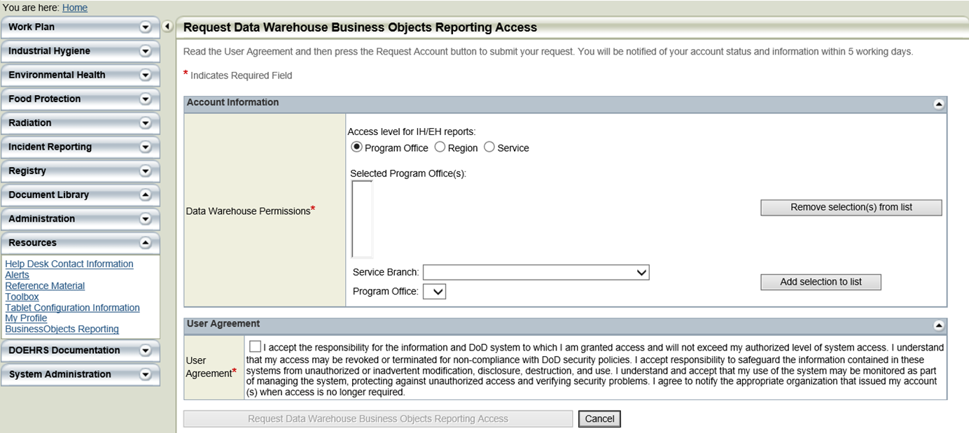
Users need DW Access Level Permissions prior to requesting BCS Account through ECRS Process

Slide 6
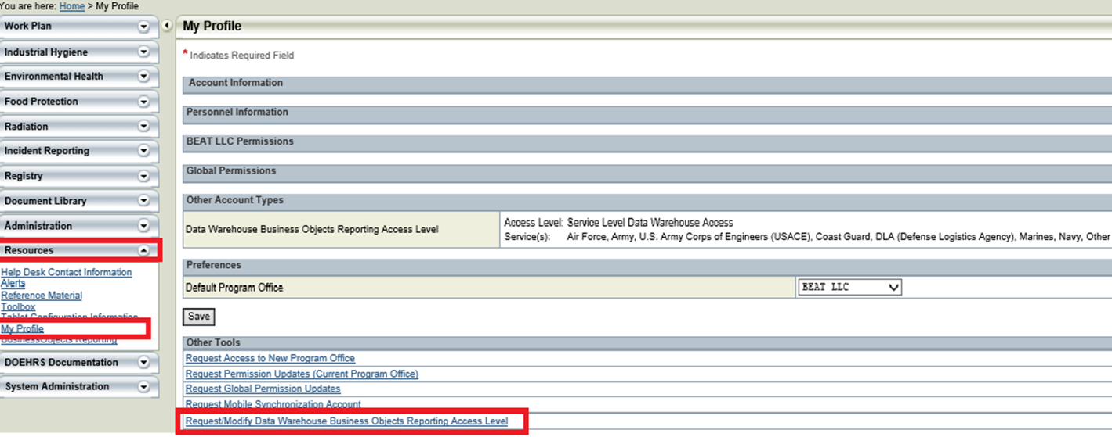
Log into DOEHRS. Go to the Resources tab in the navigation menu to the left, select the My Profile link, go to the Other Tools information tile, and then select the Request/Modify Data Warehouse Business Objects Reporting Access Level link.

Slide 7
BCS 4.2 Access Request Approval Process
BCS Access Request Approval Process:
New and change requests require four (4) levels of approval:
Commander/Supervisor (based on email provided in access request)
BCS Role Validation
BCS Role Validator approval step for each ECRS BCS access request
BCS Role Validator may change roles user has requested
SDD Access Office Approval
BCS Application Owner Approval
If the user requests access to multiple BCS Applications, their request must be approved by each respective BCS Application Owner
At least one BCS Application Owner must approve the request for the user to receive access to BCS
Reactivate requests require one (1) level of approval by the SDD Access Office Approval
BCS Access Request Approval:
After each approval step is completed, the request is sent to the next approver(s) in the approval process. The user will receive an email notification indicating who has approved or rejected the request (to the primary email address provided during CAC registration).
Requests that are rejected must be re-submitted by the user. The user can not modify their access request once it has been submitted
IMPORTANT: The ECRS workflow only allows for a request to remain for 20 days at each approval step. Hence, a request must be reviewed within 20 days or less by each approver in the workflow. If a request is not approved or rejected within 20 days, the request is automatically rejected by the system. If this occurs and the user still requires access, the user would need to resubmit their access request through ECRS.

Slide 8
BCS 4.2 Access Request Approval Process
User Submits the request.
Commander/Supervisor is the first step of approval process. The access request is sent to the supervisor email provided by the user in the request. If approved, the request moves to next step. If rejected, an email is sent to the user.
(NAVY) BCS Role Validator is the Navy Marine Corps Public Health Center. They will ensure any high level access requests (i.e., view, view on demand, report or Personally Identifiable Information (PII)) are justified by checking with the user and supervisor. The BCS Role Validator updates any changes necessary in the request. If access is approved, the request proceeds to the next step of approval. In a scenario where the BCS Role Validator does not receive the justification from the user or supervisor within a reasonable time frame, the request is rejected by the BCS Role Validator. The role of the BCS Role Validator is important to correct any information which may lead to rejection in future steps and avoid the necessity of having the user resubmitting the request due to incorrect or incomplete information.
SDD Access Office will complete the necessary checks regarding the training certificate and other requirements required for the approval. Upon completion, the request proceeds to the next step.
BCS Application Owner is the final review in the workflow to approve or reject the request. If approved, the user is provisioned in to BCS and an email notification is sent to the user.
All rejection notifications are sent to the user via email and include the reason for rejection.
Any request which has been rejected at any stage cannot be modified or resubmitted. The user is required to resubmit a new request and be processed through the same approval process.
Requests can only be modified by the BCS Role Validator.

Slide 9
ECRS Approvers
BCS Role Validators and BCS Application Owners must be military or civilian personnel only.
BCS Role Validators or BCS Application Owners for the Navy is the Navy Marine Corps Public Health Center.
Cannot be group mailboxes or distributions.
At the discretion of the BCS Member Project, a single person or multiple people can be assigned to each role
BCS Role Validators may also provide Commander/Supervisor approval for an applicant.
Applicants cannot list themselves as their Commander/Supervisor.
A BCS Role Validator may also serve as a BCS Application Owner.
SDD Access Office Approvers are assigned by SDD Leadership.
They are not assigned by ECRS, the BCS Project Office or the BCS Member Projects.
An email notification is sent to the applicant at each step in the approval process.
Only the applicant receives the email notifications regarding the status of their request.
BCS Role Validators/BCS Application Owners do not have visibility to track a request within ECRS once their review is completed.
Changes to a BCS Role Validator or BCS Application Owner must be routed to the BCS Project Office via email for submission to the ECRS Team.

Slide 10
Accessing BCS 4.2: iAS Authentication
BCS ECRS Links
New users will access the following ECRS link to submit a request to create an account in the BCS environment
https://sso.csd.disa.mil/idm/mhs/ApplicationAccessRequest.do
Users with an active BCS account will use the link below to access the BCS 4.2 launch pad
https://dha-bcs.csd.disa.mil
Upon accessing the BCS URL users will see the DOD banner and click OK, followed by the CAC authentication screen.

Slide 11
Accessing BCS 4.2: New/Expired Account
After successfully selecting their CAC certificate and entering their PIN, users with a BCS 4.2 account will be directed to the BI Launch Pad home screen.
If the BCS account is expired or the user does not have a BCS 4.2 account, the user will receive the below message with a link to the iAS Enterprise CAC Registration Service (ECRS) Automated Access Request Form (AARF) shown on the following slides.
You need a valid BCS Account to access this application.
Please visit the Access Request Page to learn more.

Slide 12
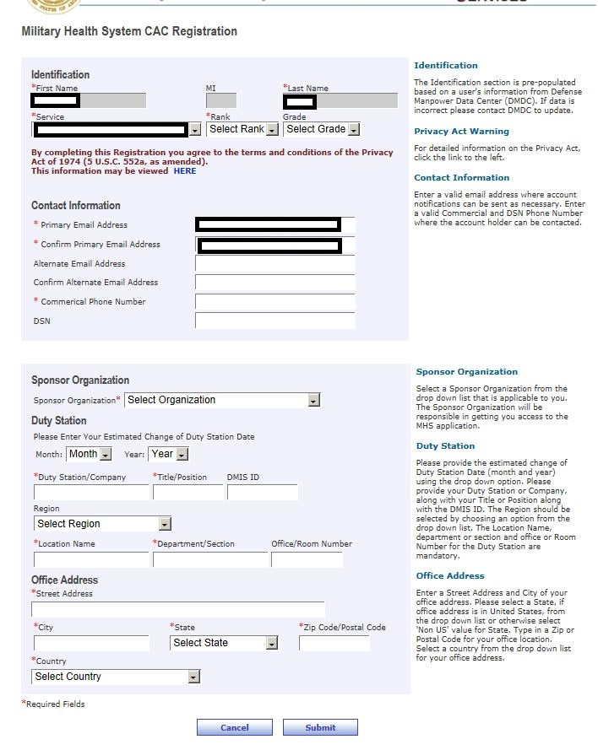
ECRS: Step 1 – New User CAC Registration
IMPORTANT: The ECRS workflow only allows for a request to remain for 20 days at each approval step. The request must be reviewed within 20 days or less by each approver in the workflow. If a request is not approved or rejected within 20 days, the request is automatically rejected by the system. If this occurs and the user still requires access, the user would need to resubmit their access request through ECRS.
Users who have used ECRS for other applications will not need to complete the CAC registration, but they may be prompted to validate their information.
New BCS 4.2 users will be redirected to this page to register their profile within ECRS.
"Service” is for Military, otherwise select “Service – NOT APPLICABLE” which is for non-military, i.e. “RANK” drop down of GS; SES; US Govt/DoD Contractor; or Non-Govt Civilian.
Sponsor Organization is not part of the ECRS approval workflow. Applicants should select the organization which best aligns to their position.
CAC Registration hyperlink: https://sso.csd.disa.mil/amserver/UI/Login?org=cac_pki&authlevel=3&ecrs=true&goto=https://sso.csd.disa.mil/idm/mhs/CACRegistration.do

Slide 13
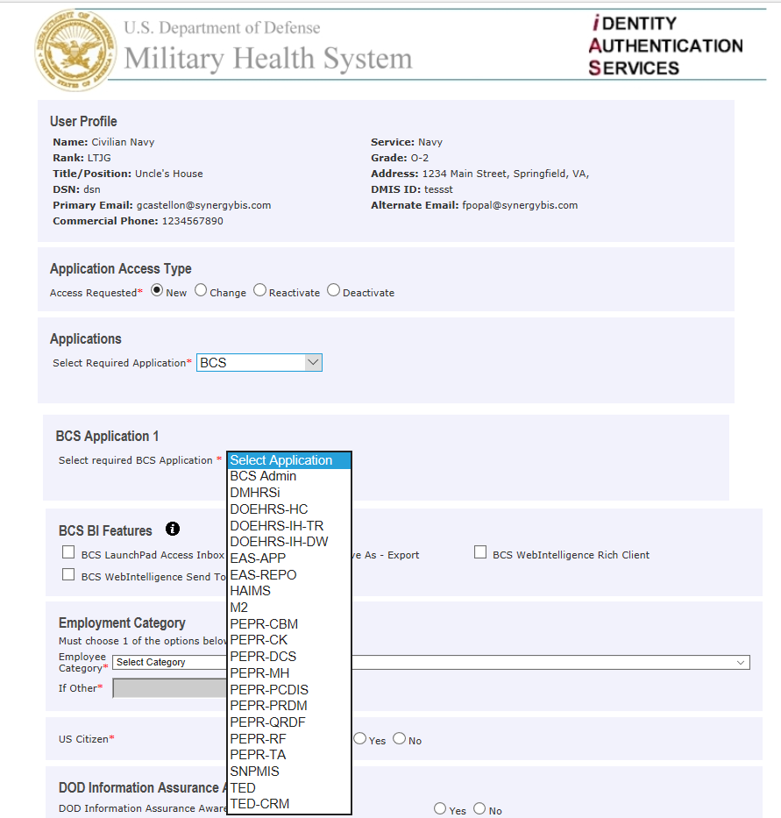
ECRS: Step 2 – Access Level Section
IMPORTANT: The ECRS workflow only allows for a request to remain for 20 days at each approval step. The request must be reviewed within 20 days or less by each approver in the workflow. If a request is not approved or rejected within 20 days, the request is automatically rejected by the system. If this occurs and the user still requires access, the user would need to resubmit their access request through ECRS.
User Profile section of the form generated from the CAC Registration data
Application Access Type and Applications section of the form are static.
ECRS Applications list. BCS Users should select BCS from the list.
List of available BCS Subscribing Applications
If a user requires access to more than one application users have the option to identify “BCS Application 2” after the first application is selected.

Slide 14
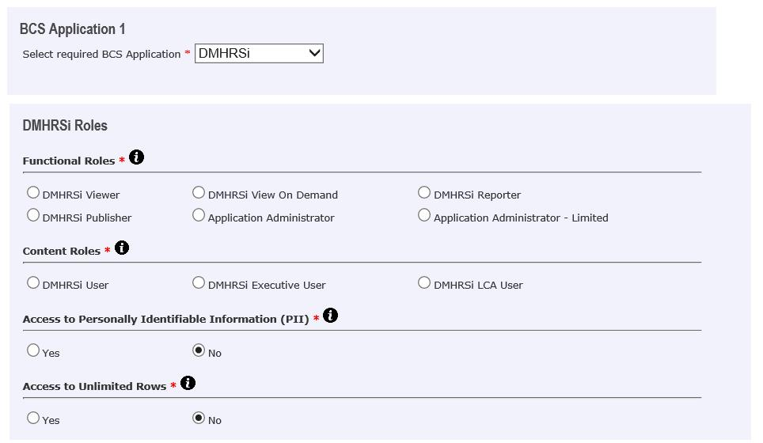
ECRS: Step 3 – Access Level Section
BCS Application (Choose DOEHRS-IH TR)
Available application roles for both functional and content.
Available functional roles are standard for Subscribing Applications
Viewer
View On Demand (Choose this for IH reports)
Publisher (Do not request)
Application Administrator (Do not request)
Capacity Services Dev or Dev-Test only
Application Administrator – Limited (Do not request)
Capacity Services Dev or Dev-Test only
Available content roles are specific to each BCS Subscribing Application
Defined by the BCS Member Projects.
Available access rights
Access to PII – Provides access to PII universe objects; Only applies to applications that store PII. Applicants should select NO if they do not access PII in their application.
Unlimited Rows – Currently, ONLY applies to M2. If selected by a M2 user, no limits are placed on the amount of data retrieved from the database. M2 is the only applications which references the Unlimited Rows role in their universes. The use of this role is limited and may require special permission for M2 users.
Examples from other projects are included in the Backup Slides for reference.

Slide 15
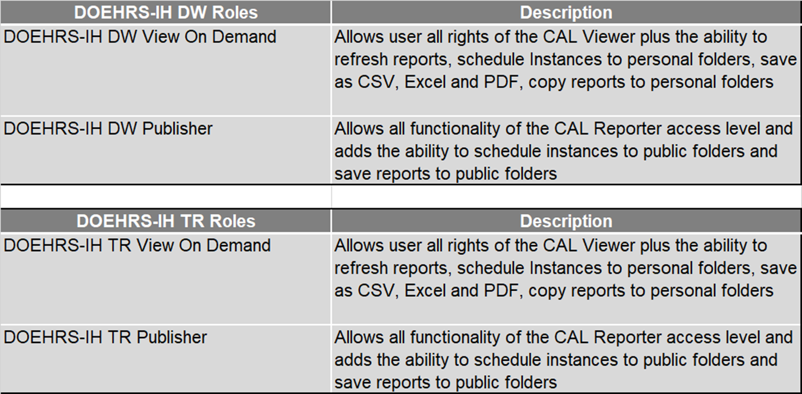
ECRS: Step 3 – Access Level Section (Functional Roles)

Slide 16
ECRS: Step 3 – Access Level Section (Content Roles)
DOEHRS-IH-DW Roles | Description
DOEHRS-IH-DW/TR EH User | Allows user to access only the content objects defined for the DOEHRS-IH-DW/TR C EH User Content group
DOEHRS-IH-DW/TR IH User | Allows user to access only the content objects defined for the DOEHRS-IH-DW/TR C IH User Content group

Slide 17
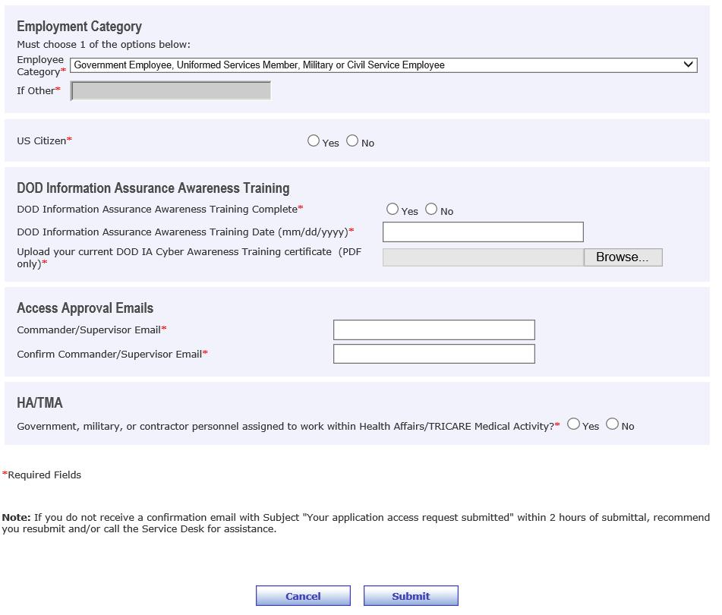
ECRS: Step 4 – Access Level Section – Employment Category
Government, Service Member, Military or Civil Service selected for Employment Category
IA Awareness Training – Used by SDD Access Office
Supervisor information – Used for supervisor approval step
Cannot be the same as the requestor
Any questions regarding an ECRS submission or failure to receive a confirmation email should be directed to the DHA Global Service Center.
Include the following text in all ECRS support tickets:
"This ticket relates to the use of the ECRS workflow for BCS and is not a question for the SDD Access Office. Please forward this ticket directly to the iAS Tier III Team at ias-tier3@chenega.com."

Slide 18
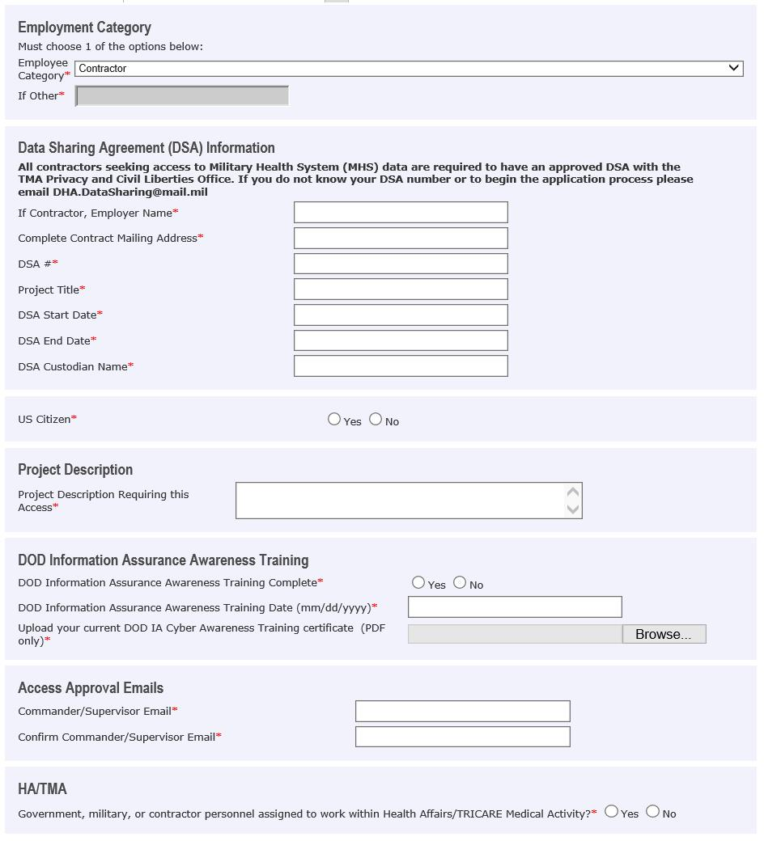
ECRS BCS Access Request Process: Step 4 - Access Level Section - Employment Category (continued)
Employment Category: Contractor selected
Data Sharing Agreement are required for all vendors with access to DHA/MHS applications.
Details on DHA's Data Sharing Requirement can be found at https://health.mil/Military-Health-Topics/Privacy-and-Civil-Liberties/Submit-a-Data-Sharing-Application. There are also templates provided and directions for the submission of the DSA by a vendor.
Project Description required for Contractors
IA Awareness Training – Required by the SDD Access Office
Supervisor information – Used for supervisor approval step
Cannot be the same as the Requestor

Slide 19
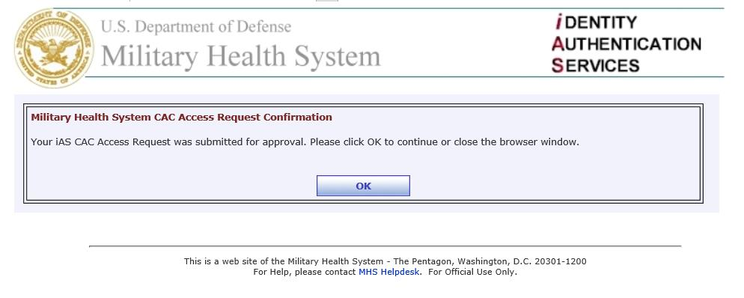
ECRS BCS Access Request Process: Step 5 - Access Level Section – Submission Confirmation
User views access request confirmation. Clicks OK to close their browser.

Slide 20
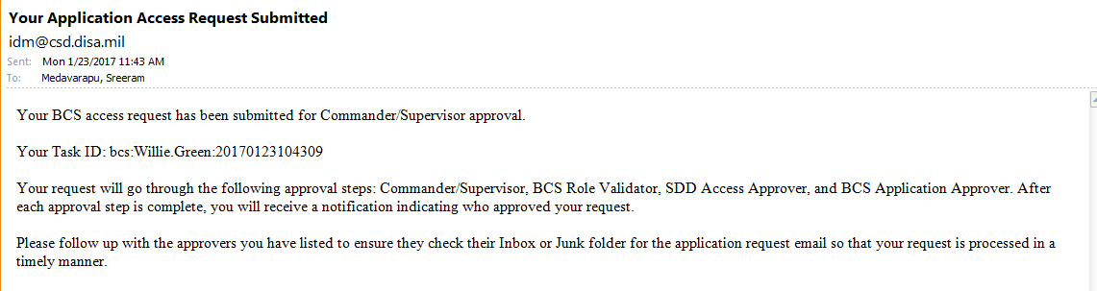
ECRS BCS Access Request Process: Step 6 - End-user Confirmation Email
After submitting an ECRS BSC access request, user will receive a confirmation email.

Slide 21
Access Change Requests
Active BCS users may request changes to their account access, including:
Application
Role
Viewer
View On Demand (Choose this for IH Reports)
Publisher (Do not request)
Access Rights
Personally Identifiable Information (PII)
Unlimited Rows
BI Features
WebI Rich Client (WebI RC)
Save As / Export
Inbox
Send To

Slide 22
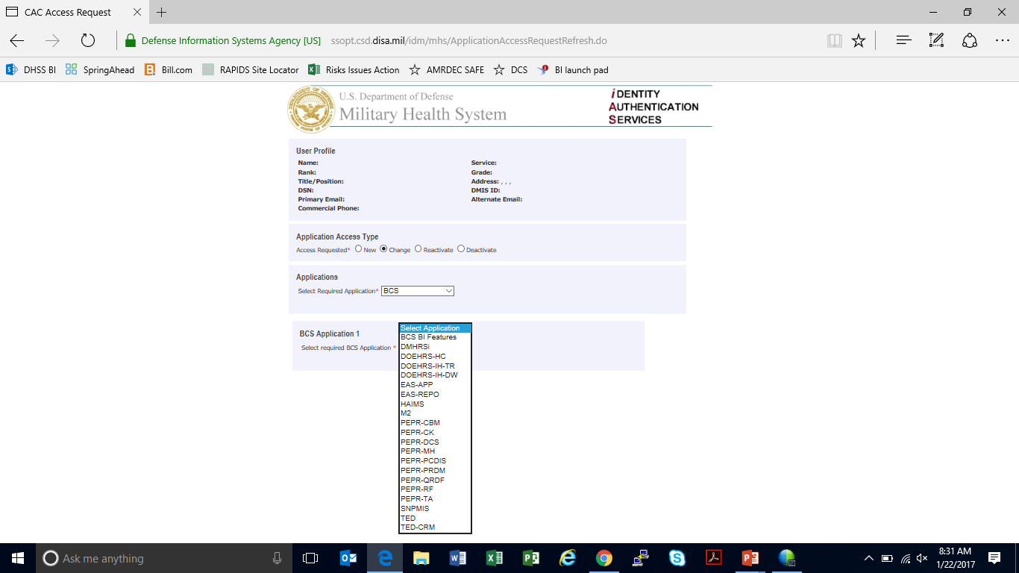
Access Change Request: Active User
Application Access Type: Select Change
Select BCS
Choose BCS Application, if not already pre-selected.
Choose DOEHRS-IH TR for IH Survey reports

Slide 23
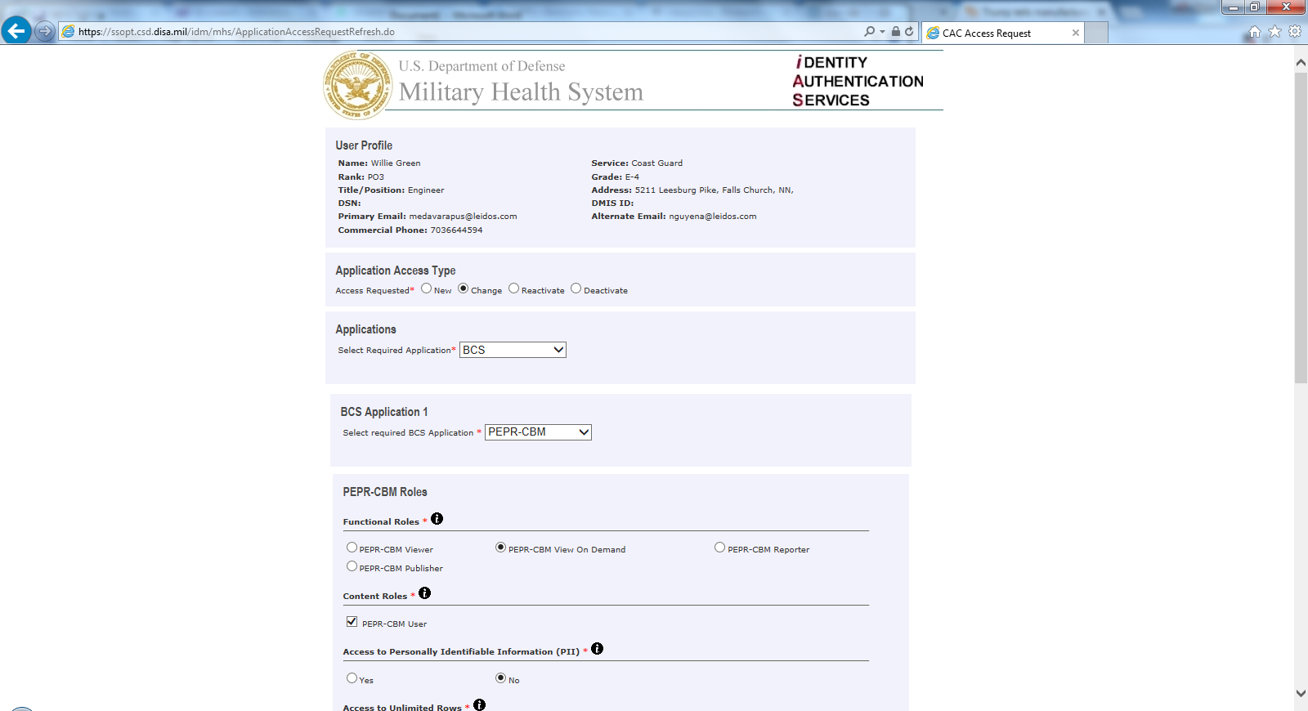
Access Change Request: Active User (cont.)
ECRS BCS Change request
BCS Application
Select Functional role(s)
Select Content role(s)

Slide 24
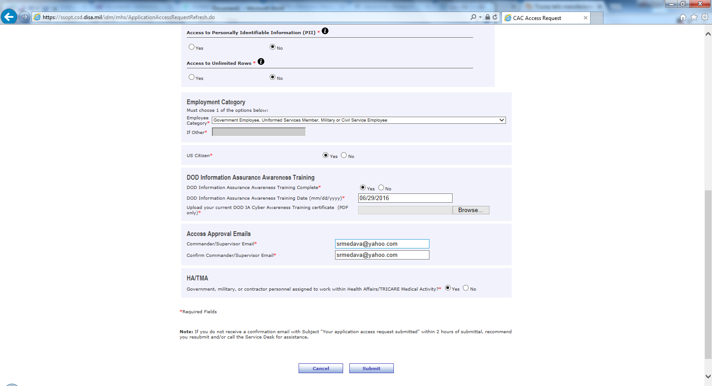
Access Change Request: Active User (cont.)
Access Rights
DOD IA Awareness Training
Available actions

Slide 25
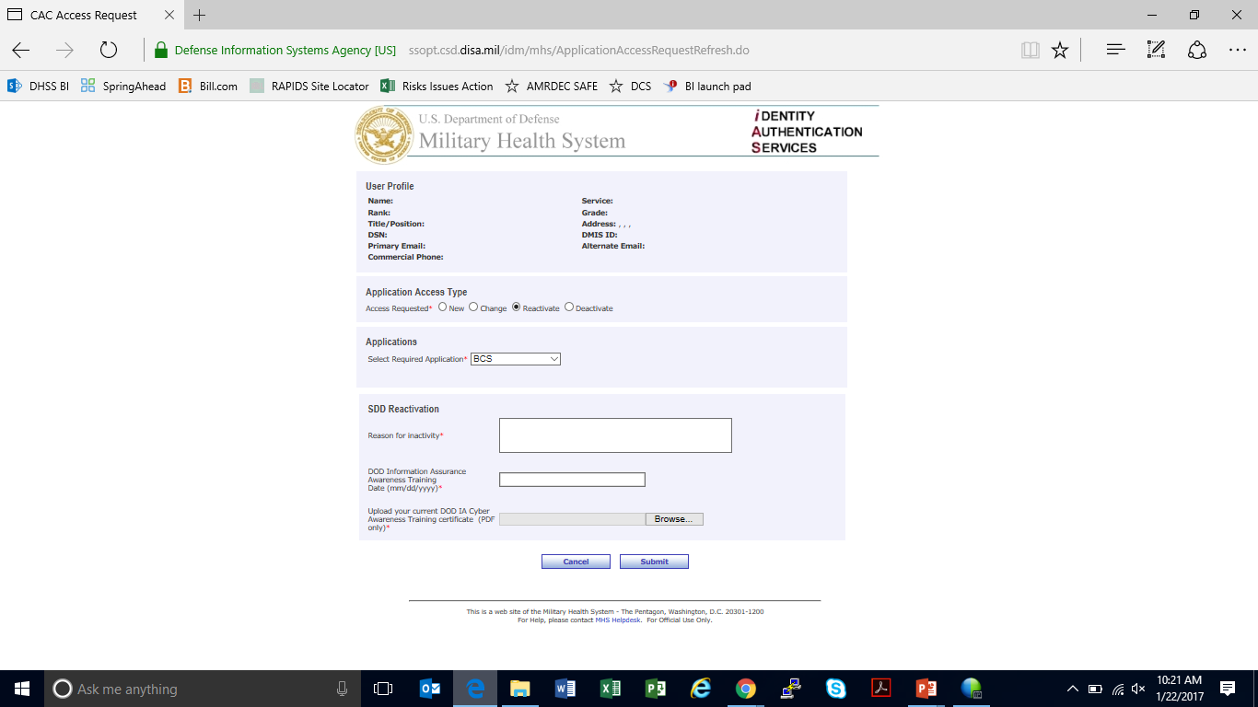
Access Reactivation Request for ECRS Inactive User
If a BCS user is inactive, they will need to “Reactivate” their account through ECRS.
The request ONLY requires SDD Access Office approval for reactivation.
Select Reactivate Application Access Type
Select BCS
The user must enter:
Reason for inactivity
Date of DOD Information Assurance Awareness Training
Upload current DOD IA Awareness Training certificate (PDF only)

Slide 26
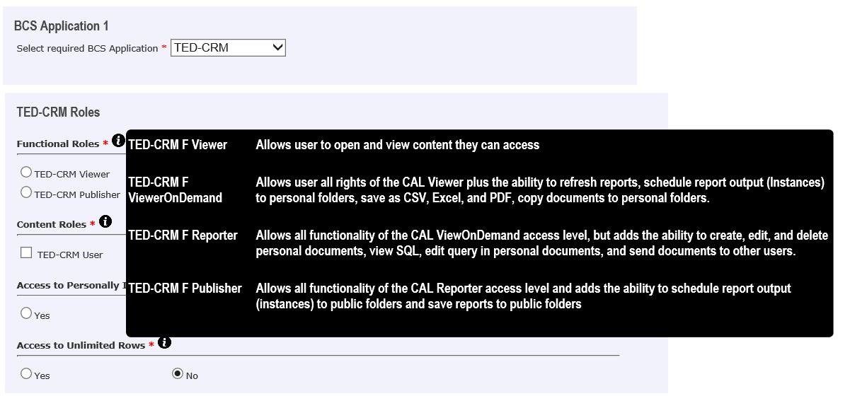
ECRS BCS Access Request: Help Text for users with Details of Access Roles
Help text is accessed by mouse over of the information icon

Slide 27
BCS 4.2 Access Request Approval Process
BCS Access Request Approval Process
New/Change requests require four levels of approval:
Commander/Supervisor (based on email provided in access request)
BCS Role Validator
BCS Role Validator approval step for each ECRS BCS access request
BCS Role Validator may change roles user has requested
SDD Access Office Approval
BCS Application Owner Approval
If user requests access to multiple BCS applications, request must be approved by each respective BCS Application Owner
At least one BCS Application Owner must approve request for user to receive access to BCS
Reactivate requests require one level of approval:
SDD Access Office approval

Slide 28
BCS 4.2 Access Request Approval Process
BCS Access Request Approval:
After each approval step is completed, the request is sent to the next approver(s) in the approval process. The user will receive an email notification indicating who has approved or rejected the request (to the primary email address provided during CAC registration).
Requests that are rejected must be re-submitted by the user. The user can not modify their access request once it has been submitted.
To check the status of your approval go to: https://sso.csd.disa.mil/idm/mhs/ECRSRequestStatus.jsp

Slide 29
Questions?
Issues related to the BCS 4.2 must be directed to the DHA Global Service Center.
DHA Global Service Center Email: dhagsc@mail.mil
DHA Global Service Desk Phone Number: (800)-600-9332, Option 2, 1
Any tickets related to ECRS should include the following instruction to avoid delays at the DHA Global Service Center:
"This ticket relates to the use of the ECRS workflow for BCS and is not a question for the SDD Access Office. Please forward this ticket directly to the iAS Tier III Team at ias-tier3@chenega.com."

